Slide 1



Knowledge Base Conversion CLI
Your very own technical assistant gpt

Slide 2
Executive Summary
Single-file CLI converts PDFs, PPTX, DOCX, XLS/XLSX, and images into GPT‑ready text
Tables preserved as TSV; figures receive OCR + PromptSuggestion to recreate clean PNGs in ChatGPT
Outputs are auditable: [SOURCE] path + slide/page anchors in every file
Upload a small number of bundle files to maximize retrieval quality in the custom GPT
Notes:
Higher-quality answers, clear provenance, and repeatable visuals for proposals/design reviews.

Slide 3
What Changed Since v1
Removed Mermaid output (inconsistent & noisy across decks)
Confidence‑aware multi‑pass OCR (multi‑scale + PSM + per‑word confidence)
One .txt per source file (no token chunking by default)
Figure typing: PARAM_TABLE / FLOW_DIAGRAM / CHART_OR_GRAPH / GENERIC_FIGURE
PromptSuggestion matched to type (rebuild table/chart/flow as PNG)
Notes:
We bias to data fidelity and reproducibility over ASCII diagrams.

Slide 4
Solution Overview (CLI)
Inputs: PDF, PPTX, DOCX, XLS/XLSX, PNG/JPG
Extract text + preserve tables (TSV)
OCR for scans & pictures (confidence‑aware)
Tag figure blocks + add PromptSuggestion
Emit one .txt per file, then bundle for GPT upload
Notes:
Simple operation and deterministic outputs suitable for handover.

Slide 5
Data Flow (Pipeline)
Input → Extract text/tables → OCR scans & pictures
Figure typing + PromptSuggestion → Clean/normalize
Write .txt per file → Bundle for GPT
Notes:
Table‑first; figures are guidance to regenerate visuals as PNGs in ChatGPT.

Slide 6
Output Format & Guarantees
Traceable anchors
[SOURCE] <full\path\to\file>
=== Slide N === / === PDF Page N ===
Tables preserved
[Table N] followed by tab-separated rows (DataFrame-ready)
Original units retained; any conversions labeled separately
Figures captured
[Picture on Slide N | TYPE] with OCR summary + PromptSuggestion to recreate a clean PNG (chart/flow/illustration)
No Mermaid artifacts
Visuals are regenerated from text evidence inside ChatGPT
Audit & compliance
Every answer must end with Sources: FILE → Slide N → [Table/ Picture | TYPE]
No external knowledge; unknowns flagged; conflicts reported transparently
Notes:
Anchors enable precise citations and reproducible visuals.

Slide 7
USE CASES

Slide 8
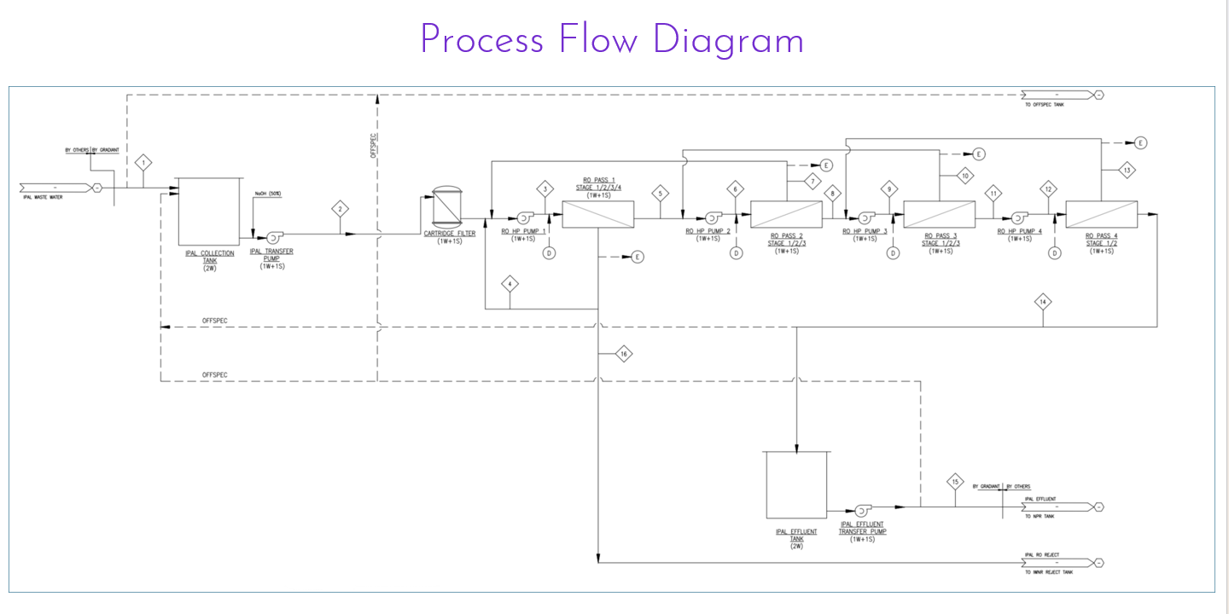

Slide 9
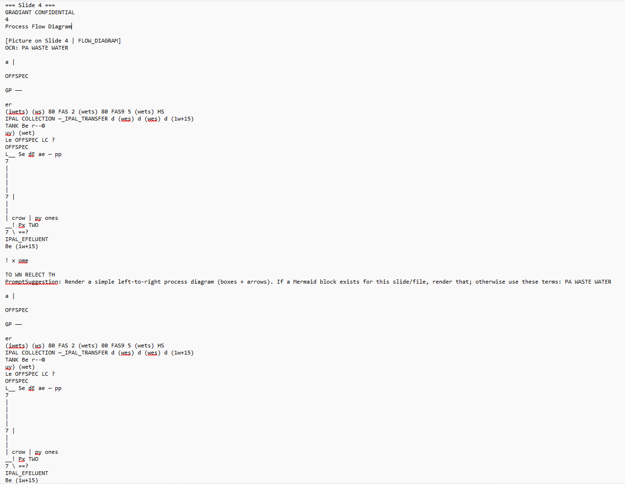

Slide 10
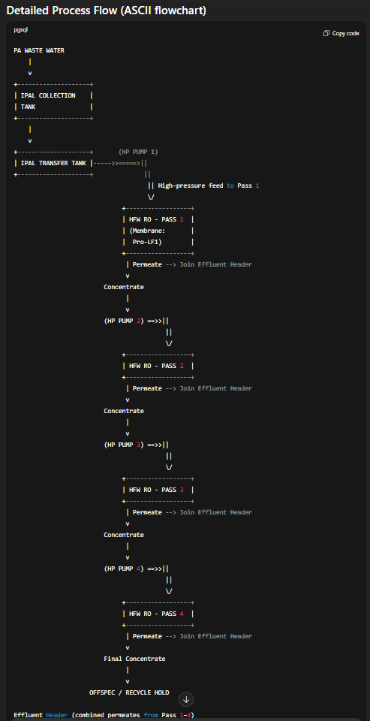

Slide 11

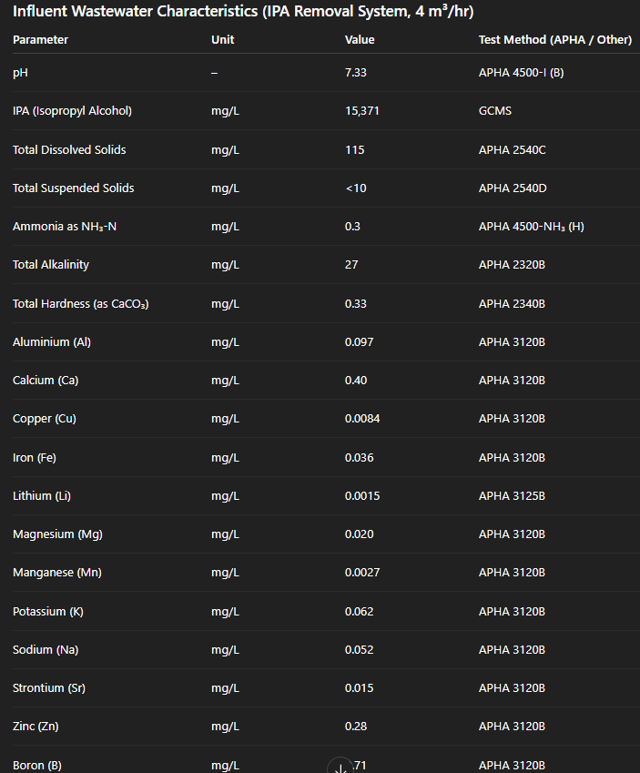
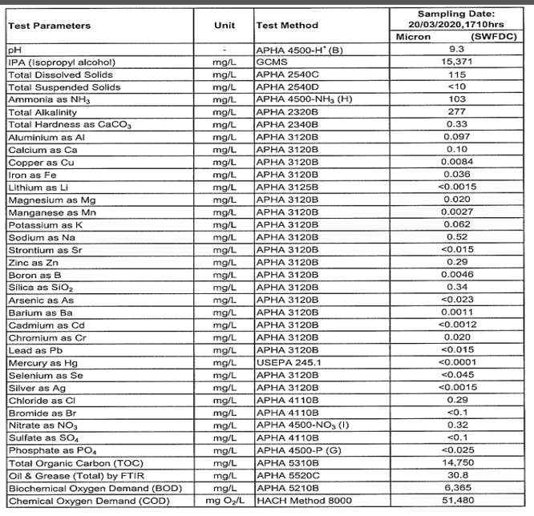

Slide 12
https://chatgpt.com/share/e/68b6b8a4-5668-800a-a110-93d7b66670de

Slide 13

